Slide 1
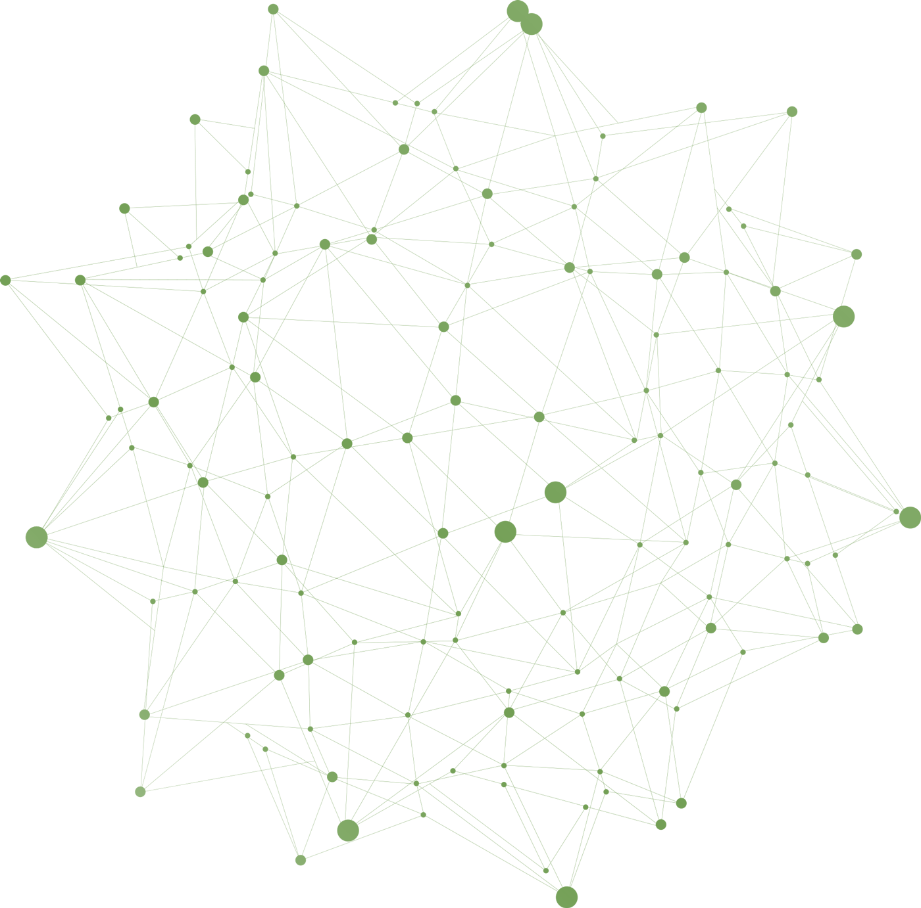


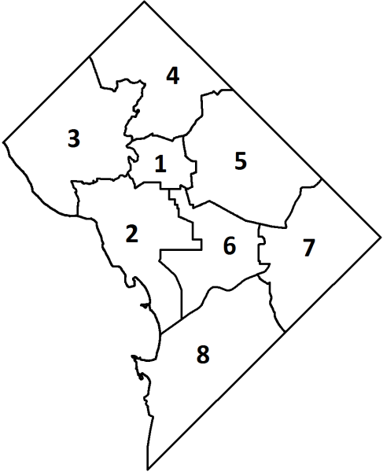


AirBnB Investment
Prepared by
Hamad Alharthi

Slide 2

AirBnB Investment
Main Prompt: Should you invest in an Airbnb hotel in Washington, D.C.?
If so, in which neighborhood should they invest?
Prompt 1: Host revenue — How much revenue do successful hosts generate?
Prompt 2: Property reviews — Which property types receive the most positive reviews?
Frame
Prepare
Interpret
Communicate
Analyze

Slide 3
AirBnB Investment
Preparing and cleaning data:
Check for duplicates.
Remove all hyperlinks columns.
Remove unneeded, empty or one value columns. For example (scrape_id, last_scraped, experiences_offered, summary, jurisdiction_names and requires_license etc.)
Remove all listings without reviews (Rows). (830) rows removed out of (3723).
Impute zero values in guests_included column by using "if statement" which will look to accommodates' column and if the value=1 then return 1. Else, return 2.
Replace all blank values in review_scores_location with zero.
Frame
Prepare
Analyze
Interpret
Communicate

Slide 4
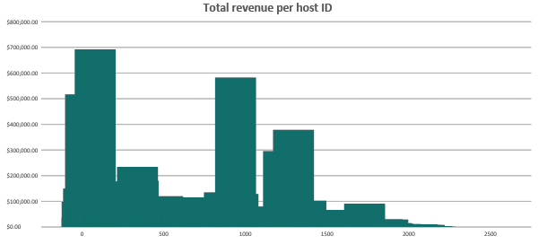
AirBnB Investment
Prompt 1: Host revenue — How much revenue do successful hosts generate?
Frame
Prepare
Analyze
Interpret
Communicate

Slide 5
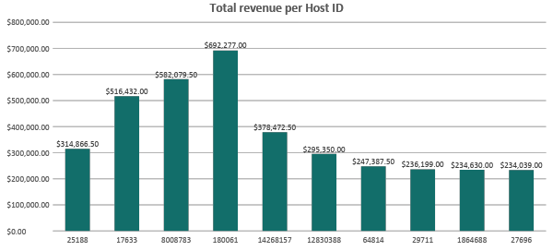
AirBnB Investment
Prompt 1: Host revenue — How much revenue do successful hosts generate?
Frame
Prepare
Analyze
Interpret
Communicate

Slide 6



AirBnB Investment
Prompt 1: Host revenue — How much revenue do successful hosts generate?
Host Name: Hermosa
Total revenue: $692,277.00
Number of listings: 2
2
0
Host Name: Cliff
Total revenue: $582,079.50
Number of listings: 26
Host Name: Charlotte
12
14
Total revenue: $516,432.00
Number of listings: 28
1st
5
23
2nd
3rd
Frame
Prepare
Analyze
Interpret
Communicate

Slide 7
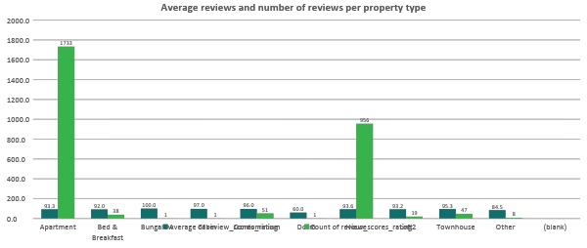
AirBnB Investment
Prompt 2: Property reviews — Which property types receive the most positive reviews?
Frame
Prepare
Analyze
Interpret
Communicate

Slide 8
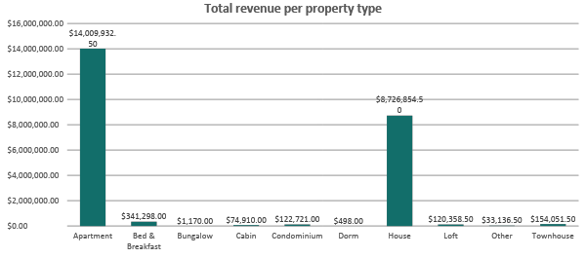
AirBnB Investment
Prompt 2: Property reviews — Which property types receive the most positive reviews?
Frame
Prepare
Analyze
Interpret
Communicate

Slide 9
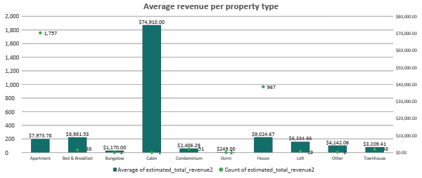
AirBnB Investment
Prompt 2: Property reviews — Which property types receive the most positive reviews?
Frame
Prepare
Analyze
Interpret
Communicate

Slide 10
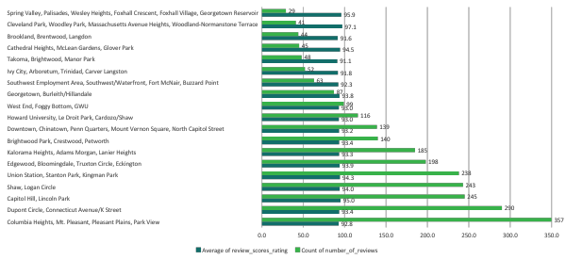
AirBnB Investment
Main Prompt: Should you invest in an Airbnb hotel in Washington, D.C.?
If so, in which neighborhood should they invest?
Frame
Prepare
Analyze
Interpret
Communicate

Slide 11
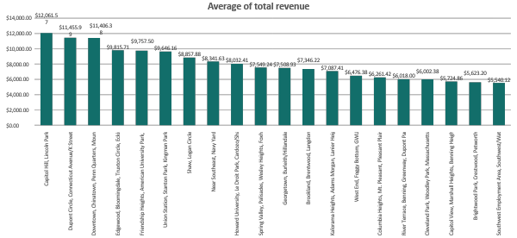
AirBnB Investment
Main Prompt: Should you invest in an Airbnb hotel in Washington, D.C.?
If so, in which neighborhood should they invest?
Frame
Prepare
Analyze
Interpret
Communicate

Slide 12
AirBnB Investment
Main Prompt: Should you invest in an Airbnb hotel in Washington, D.C.?
If so, in which neighborhood should they invest?
Neighborhood | AVG. review score | AVG. revenue
Capitol Hill, Lincoln Park | 95.0 | $12,061.57
Dupont Circle, Connecticut Avenue/K Street | 93.4 | $11,455.99
Downtown, Chinatown, Penn Quarters, Mount Vernon Square, North Capitol Street | 93.2 | $11,406.38
Edgewood, Bloomingdale, Truxton Circle, Eckington | 93.9 | $9,815.71
Friendship Heights, American University Park, Tenleytown | 90.0 | $9,757.50
Union Station, Stanton Park, Kingman Park | 94.3 | $9,646.16
Shaw, Logan Circle | 94.0 | $8,857.88
Near Southeast, Navy Yard | 95.3 | $8,341.63
Howard University, Le Droit Park, Cardozo/Shaw | 93.0 | $8,032.41
Spring Valley, Palisades, Wesley Heights, Foxhall Crescent, Foxhall Village, Georgetown Reservoir | 95.9 | $7,549.24
Georgetown, Burleith/Hillandale | 93.8 | $7,508.93
Brookland, Brentwood, Langdon | 91.6 | $7,346.22
Kalorama Heights, Adams Morgan, Lanier Heights | 93.3 | $7,087.41
West End, Foggy Bottom, GWU | 93.0 | $6,476.38
Columbia Heights, Mt. Pleasant, Pleasant Plains, Park View | 92.8 | $6,261.42
River Terrace, Benning, Greenway, Dupont Park | 88.8 | $6,018.00
Cleveland Park, Woodley Park, Massachusetts Avenue Heights, Woodland-Normanstone Terrace | 97.1 | $6,002.38
Capitol View, Marshall Heights, Benning Heights | 96.7 | $5,724.86
Brightwood Park, Crestwood, Petworth | 93.4 | $5,623.20
Southwest Employment Area, Southwest/Waterfront, Fort McNair, Buzzard Point | 92.3 | $5,540.12
Frame
Prepare
Analyze
Interpret
Communicate

Slide 13
AirBnB Investment
Main Prompt: Should you invest in an Airbnb hotel in Washington, D.C.?
If so, in which neighborhood should they invest?
# | Neighborhood | AVG. review score Weigh (0.4) | AVG. revenue Weigh (0.6) | Score
1 | Capitol Hill, Lincoln Park | 0.748 | 1.000 | 0.899
2 | Dupont Circle, Connecticut Avenue/K Street | 0.550 | 0.907 | 0.764
3 | Downtown, Chinatown, Penn Quarters, Mount Vernon Square, North Capitol Street | 0.531 | 0.900 | 0.752
4 | Edgewood, Bloomingdale, Truxton Circle, Eckington | 0.615 | 0.656 | 0.639
5 | Friendship Heights, American University Park, Tenleytown | 0.141 | 0.647 | 0.444
6 | Union Station, Stanton Park, Kingman Park | 0.664 | 0.630 | 0.643
7 | Shaw, Logan Circle | 0.619 | 0.509 | 0.553
8 | Near Southeast, Navy Yard | 0.774 | 0.430 | 0.567
9 | Howard University, Le Droit Park, Cardozo/Shaw | 0.503 | 0.382 | 0.430
10 | Spring Valley, Palisades, Wesley Heights, Foxhall Crescent, Foxhall Village, Georgetown Reservoir | 0.856 | 0.308 | 0.527
11 | Georgetown, Burleith/Hillandale | 0.594 | 0.302 | 0.419
12 | Brookland, Brentwood, Langdon | 0.330 | 0.277 | 0.298
13 | Kalorama Heights, Adams Morgan, Lanier Heights | 0.543 | 0.237 | 0.360
14 | West End, Foggy Bottom, GWU | 0.503 | 0.144 | 0.287
15 | Columbia Heights, Mt. Pleasant, Pleasant Plains, Park View | 0.475 | 0.111 | 0.256
16 | River Terrace, Benning, Greenway, Dupont Park | 0.000 | 0.073 | 0.044
17 | Cleveland Park, Woodley Park, Massachusetts Avenue Heights, Woodland-Normanstone Terrace | 1.000 | 0.071 | 0.443
18 | Capitol View, Marshall Heights, Benning Heights | 0.951 | 0.028 | 0.397
19 | Brightwood Park, Crestwood, Petworth | 0.548 | 0.013 | 0.227
20 | Southwest Employment Area, Southwest/Waterfront, Fort McNair, Buzzard Point | 0.424 | 0.000 | 0.170
Frame
Prepare
Analyze
Interpret
Communicate

Slide 14
AirBnB Investment
Recommendation
Neighborhood:
Capitol Hill, Lincoln Park (6)
AVG. revenue:
$12,061.57
AVG. review rate:
95.0
Property type:
$12,803.61
$11,864.83
109
129
House
Apartment
Frame
Prepare
Analyze
Interpret
Communicate

Slide 15
Thank You

